Slide 1
Feature Selection in Machine Learning
for BioMedical Data
Nov 25 2024
Giảng viên: TS. Lưu Phúc Lợi
Luu.p.loi@googlemail.com

Slide 2
Content of Lecture 1
Introduction to Feature Selection
Filter method
Wrapper methods
Embedded method

Slide 3
Introduction to Feature Selection

Slide 4
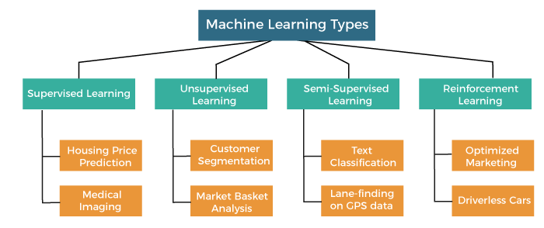

Slide 5
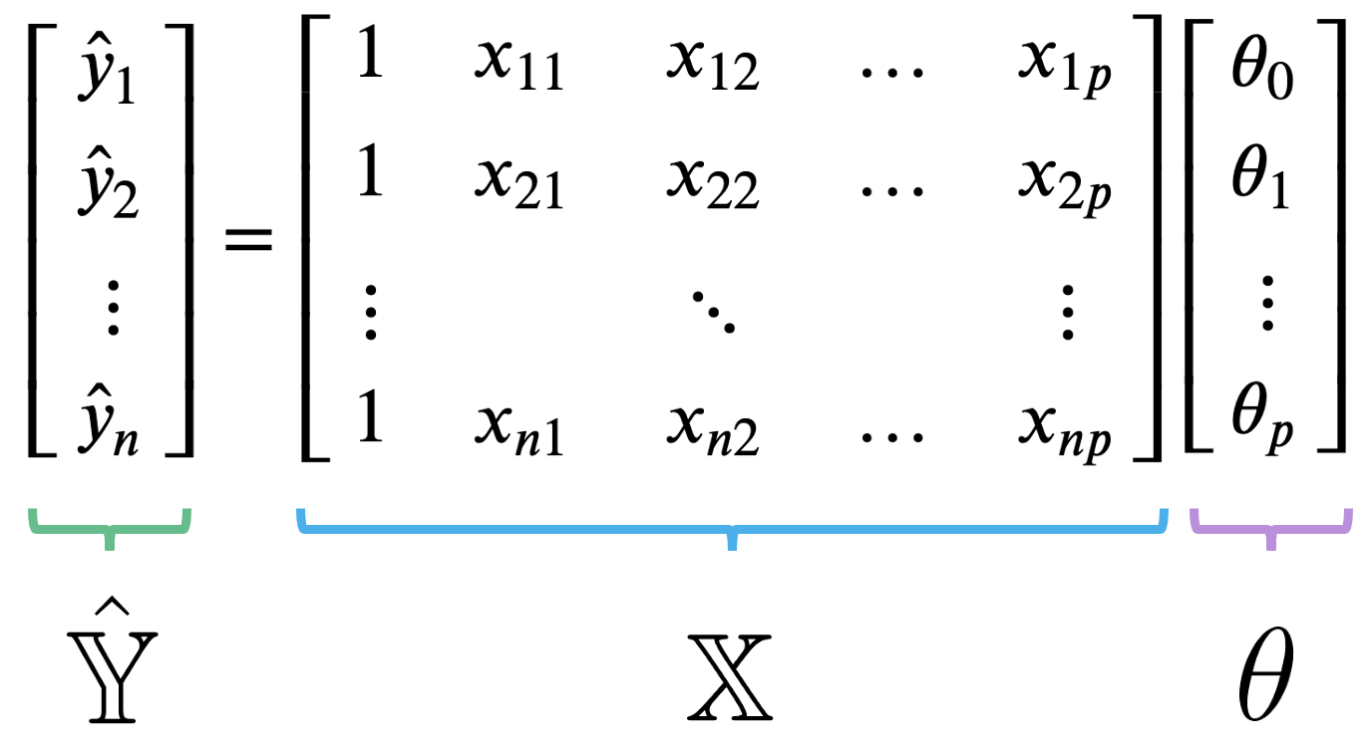
Supervise Learning: regression or classification

Slide 6
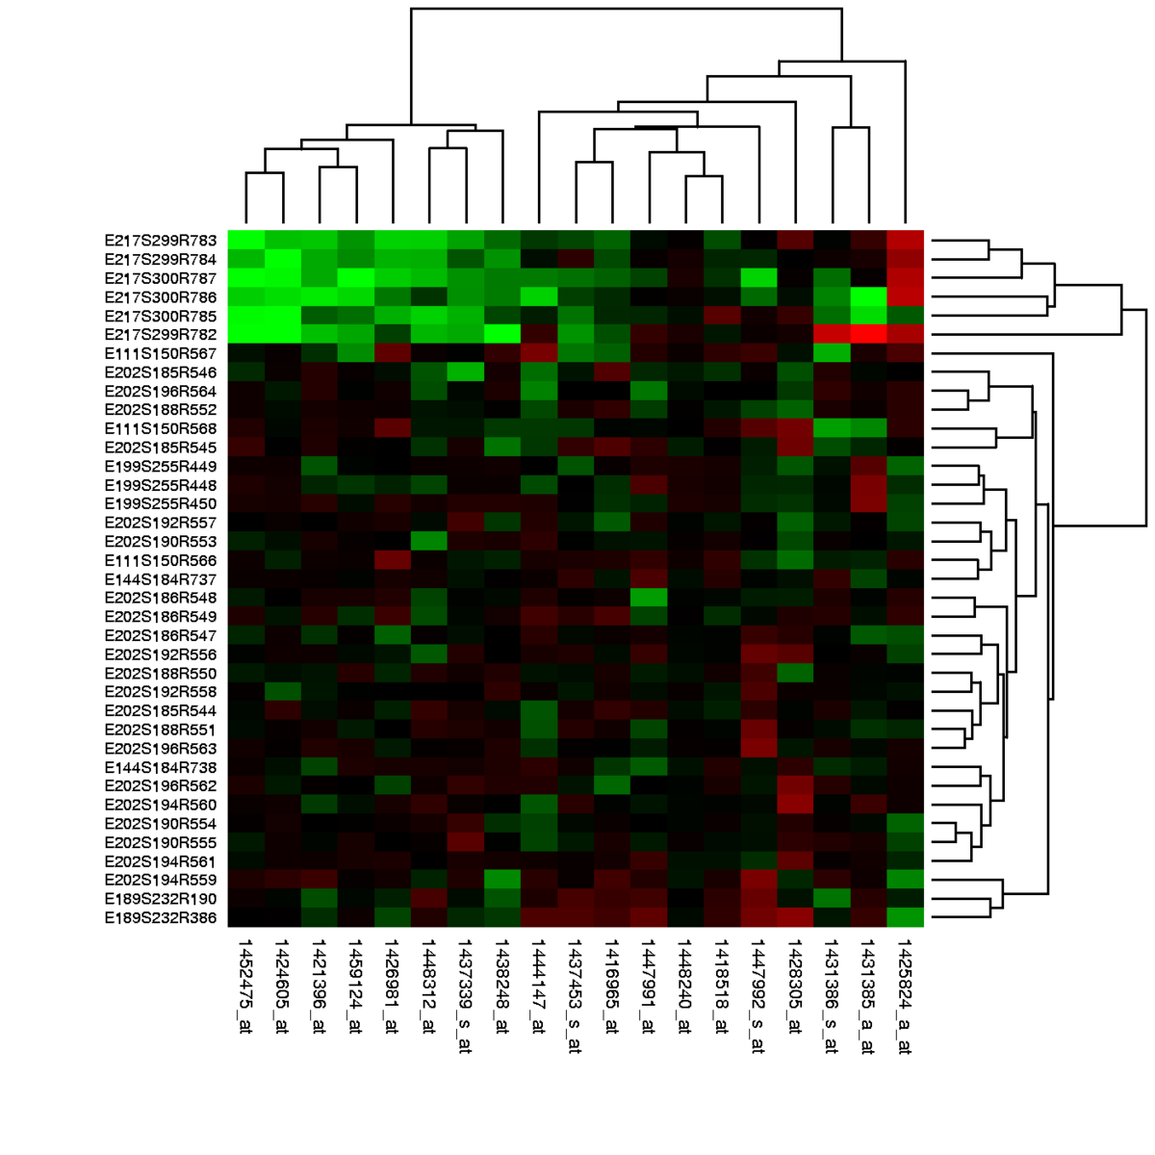
BioMedical data: gene expression with p >> n
n = number of samples 6, 10, 100, 1k
P = number of genes 20k
https://en.wikipedia.org/wiki/Gene_expression_profiling

Slide 7
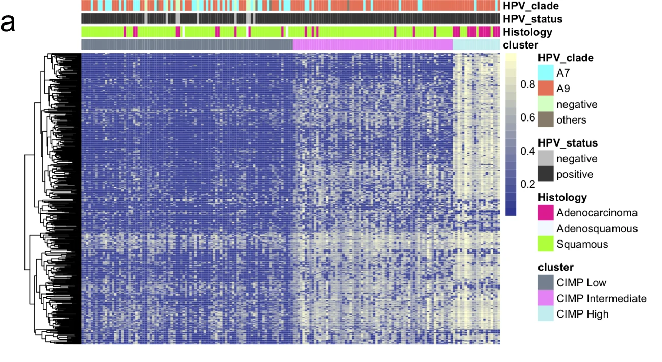
BioMedical data: DNA methylation (p >> n)
n = number of samples 6, 10, 100, 1k
P = number of CpG 28M
https://www.nature.com/articles/s41392-019-0081-6/figures/1

Slide 8
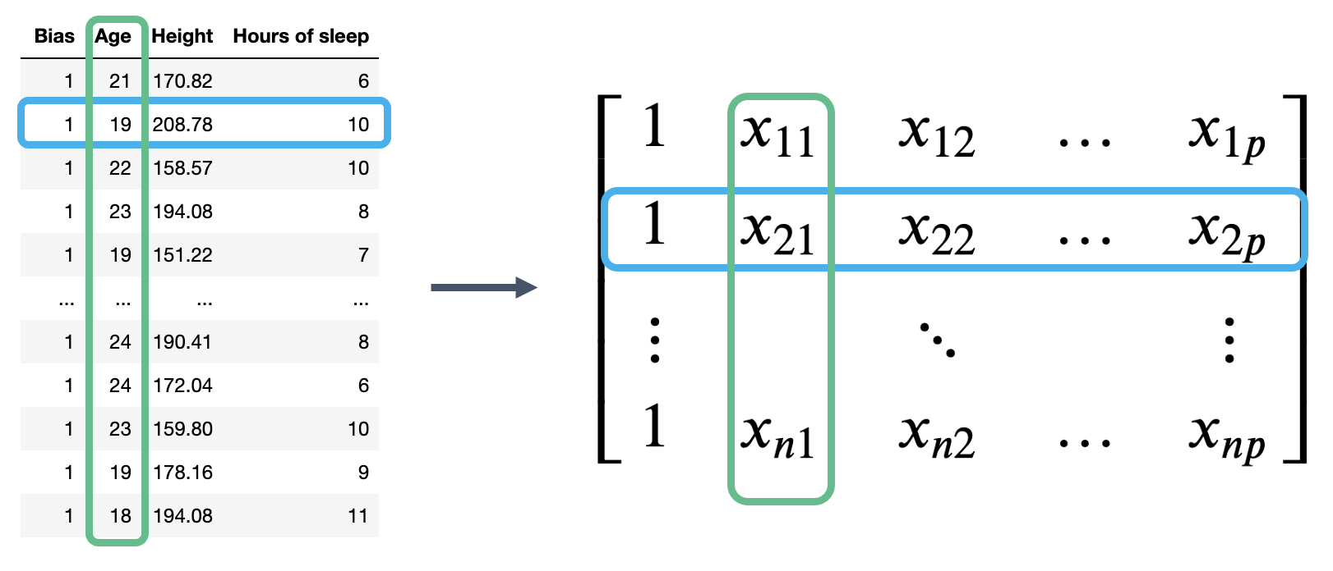
What is feature/variable selection?
Find the features (variables/columns) in X which are important for predicting, and remove the features that are not
Give:
Find the columns in X which are important for predicting y
https://ds100.org/course-notes/ols/ols.html
https://ubc-cs.github.io/cpsc330-2023W1/lectures/13_feature-engineering-selection.html

Slide 9
Why feature selection?
Interpretability: Models are more interpretable with fewer features. If you get the same performance with 10 features instead of 500 features, why not use the model with smaller number of features?
Computation: Models fit/predict faster with fewer columns.
Data collection: What type of new data should I collect? It may be cheaper to collect fewer columns.
Fundamental tradeoff: Can I reduce overfitting by removing useless features?
Feature selection can often result in better performing (less overfit), easier to understand, and faster model.
https://ubc-cs.github.io/cpsc330-2023W1/lectures/13_feature-engineering-selection.html

Slide 10
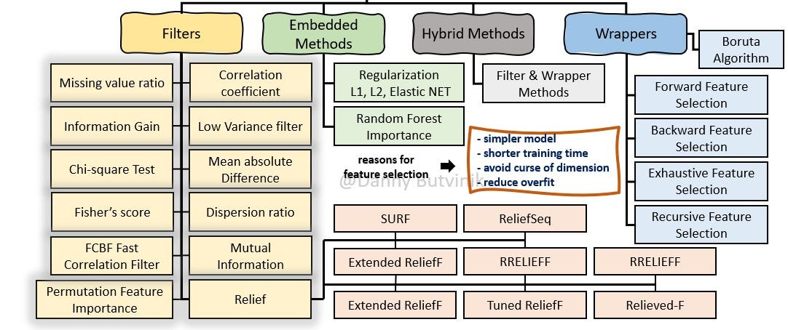
How do we carry out feature selection? Supervised Feature Selection
https://medium.com/analytics-vidhya/feature-selection-extended-overview-b58f1d524c1c

Slide 11
Model Selection vs Feature Selection
Feature Selection is a part of Model Selection

Slide 12
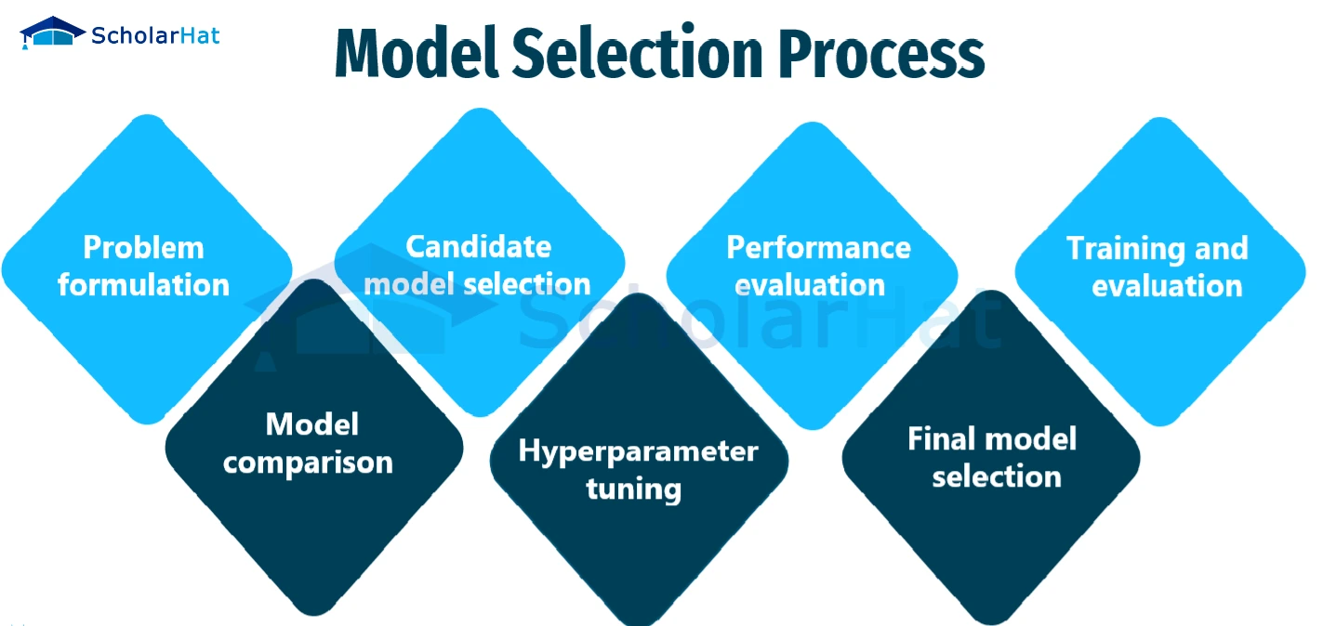
Model selection: steps
https://www.scholarhat.com/tutorial/machinelearning/model-selection-for-machine-learning

Slide 13
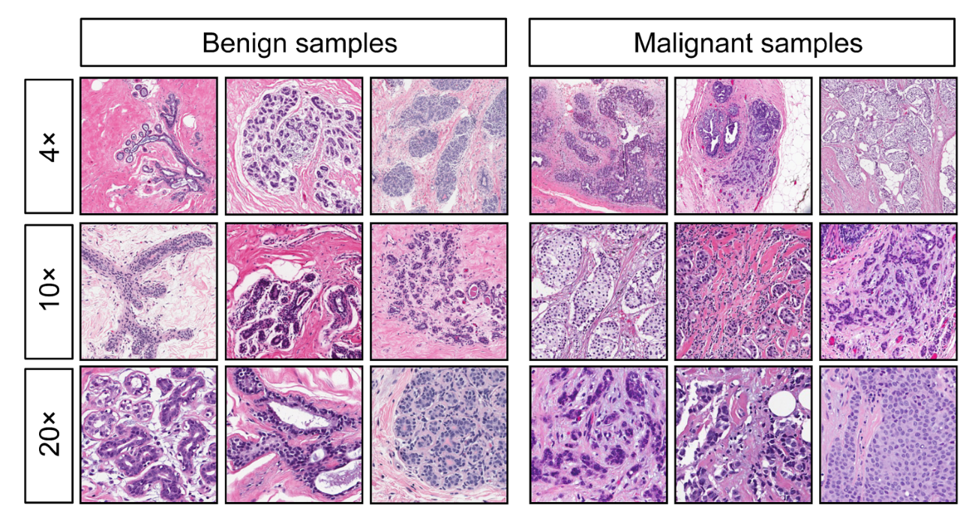
Model selection: steps
Stage 1: Selecting the regression model forms
Stage 2: Selecting the regression model and the independent variables
Stage 3: Fitting the model
Stage 4: Examining or validation of the applied model
https://www.shiksha.com/online-courses/articles/model-selection-in-machine-learning-regression/
https://medium.com/analytics-vidhya/breast-cancer-diagnostic-dataset-eda-fa0de80f15bd

Slide 14
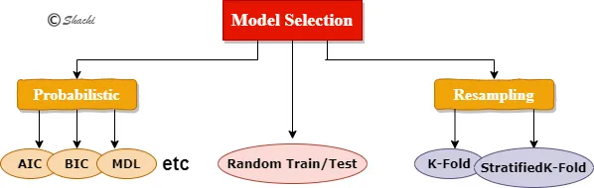
Model selection: methods
https://medium.com/analytics-vidhya/model-selection-techniques-in-ml-ai-with-python-fdf308d9fa10

Slide 15
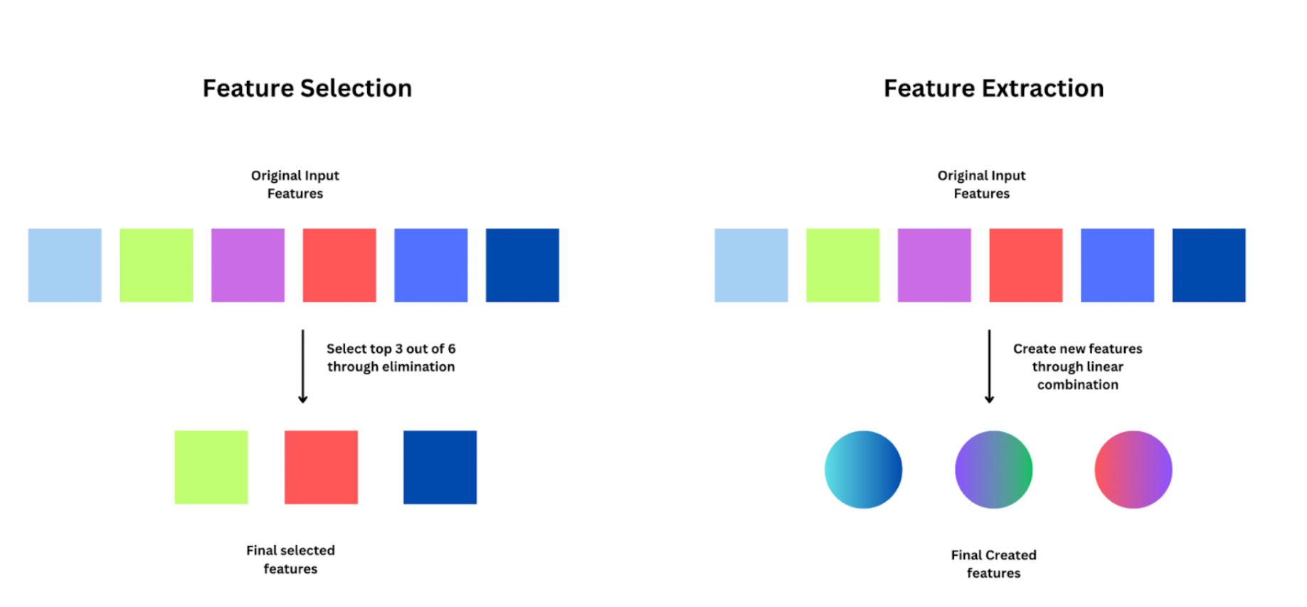
Feature Selection vs Feature Extraction/Engineering
https://viso.ai/deep-learning/feature-extraction-in-python/

Slide 16
Xin chân thành cảm ơn!
Luu Phuc Loi, PhD
Zalo: 0901802182
luu.p.loi@googlemail.com

